Slide 1
THE Saint-Gobain GROUP
MARCH 2022

Slide 2
SEAMLESS ACOUSTIC CEILING SYSTEM

Slide 3
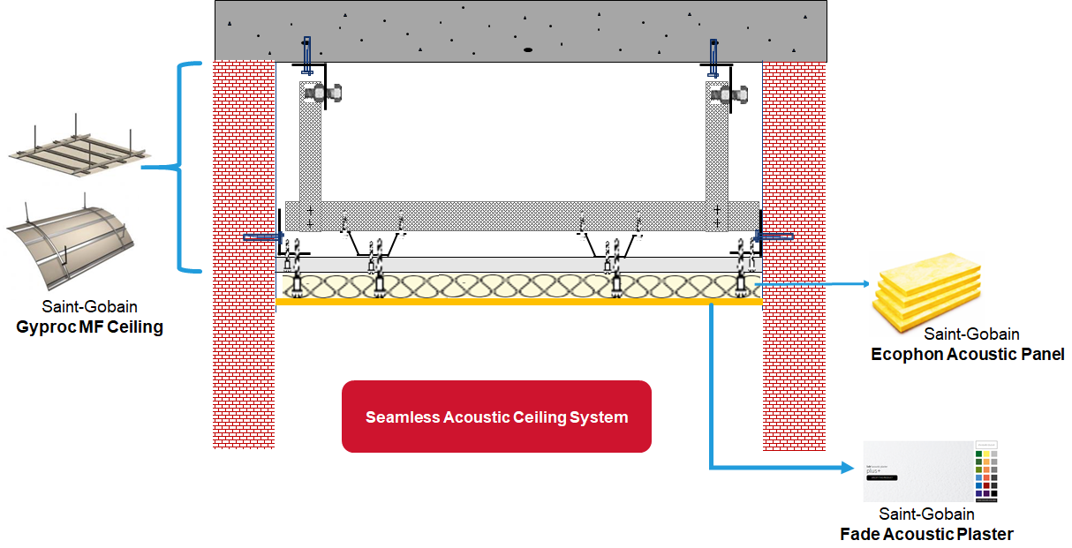
Product to system solution

Slide 4
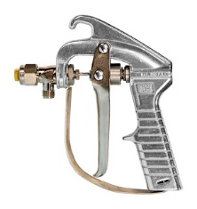
Installation of Ecophon fade seamless acoustic ceiling system
Below detail is for understanding purpose only
25 & 40mm Saint-Gobain E Acoustic Panel
Saint-Gobain
Fade Acoustic Plaster
0.8 & 0.9NRC
MF Seamless Sound Acoustic solution

Slide 5
Integration with other ceiling solutions
Below details are for understanding purpose only
When combined with Fire Rated & other MF ceiling assembly, the performance of it too can be added to the attributes.
Curve
GAH Acoustic Hanger
60mins Fire Rated
Mass Barrier
120mins Fire Rated
Framing Thickness & Framing Distance Vary based on load

Slide 6
Sound absorption performance of Ecophon fade
ULTRA SMOOTH FINISH
25mm Thick : 0.80 NRC | 0.85 α_{w}
40mm Thick : 0.90 NRC | 0.90 α_{w}
SMOOTH FINISH
40mm Thick : 1.0 NRC | 0.95 α_{w} 40mm Thick : 1.0 NRC | 1.0 α_{w}

Slide 7
Sound insulation performance using mf gypsum ceiling
5
Detail | Air Cavity | Board Type | Board Thickness | Insulation | Sound Insulation between floor Rw | Lnw | CAC Rw | STC (Based on partition assembly) | Sound Insulation between MEP to ceiling Rw | STC (Based on software prediction)
1 | 240mm | Saint-Gobain Fire Rated | 1x12.5mm | N/A | 56dB | 68dB | 39dB | 41dB | 28dB | 27dB
2 | 240mm | Saint-Gobain Fire Rated | 2x12.5mm | N/A | 60dB | 64dB | 46dB | 47dB | 34dB | 33dB
3 | 240mm | Saint-Gobain Fire Rated | 1x12.5mm | 100mm (16Kg/m3) | 61dB | 60dB | 44dB | 44dB | 31dB | 31dB
4 | 240mm | Saint-Gobain Fire Rated | 2x12.5mm | 100mm (16Kg/m3) | 64dB | 57dB | 53dB | 53dB | 37dB | 37dB
5 | 240mm | Saint-Gobain Fire Rated | 3x15.9mm | 50mm (50Kg/m3) | 64dB | 57dB | 53dB | 53dB | 47dB | 47dB
MF Ceiling installed below to 150mm Thick Concrete slab with air cavity of 240mm.

Slide 8
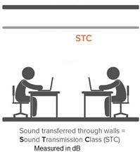
Offers all in one acoustic solution
L_{nTw}
Sound transferred through Ceiling
Sound Transmission Class (STC) measured in dB
All above are laboratory Test measurement

Slide 9
Ecophon fade seamless acoustic ceiling installation video
Fixation detail below Saint-Gobain MF Ceiling Assembly

Slide 10
Ecophon fade seamless acoustic ceiling maintenance & repair video
Excellent Spot Repair feasibility

Slide 11
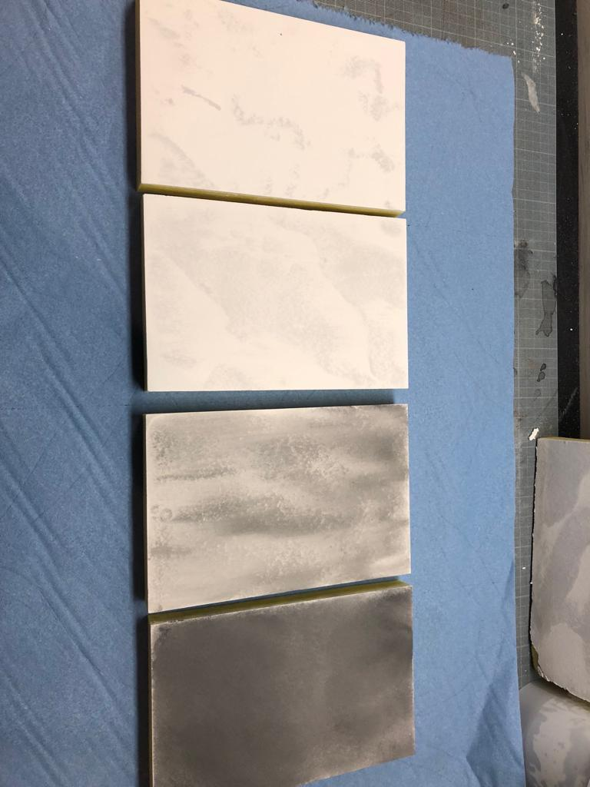
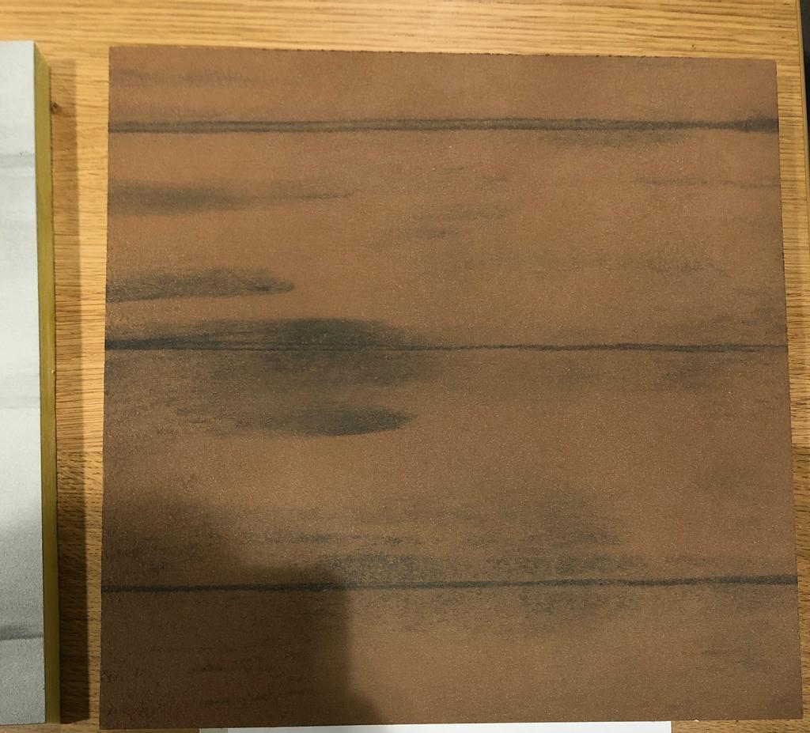
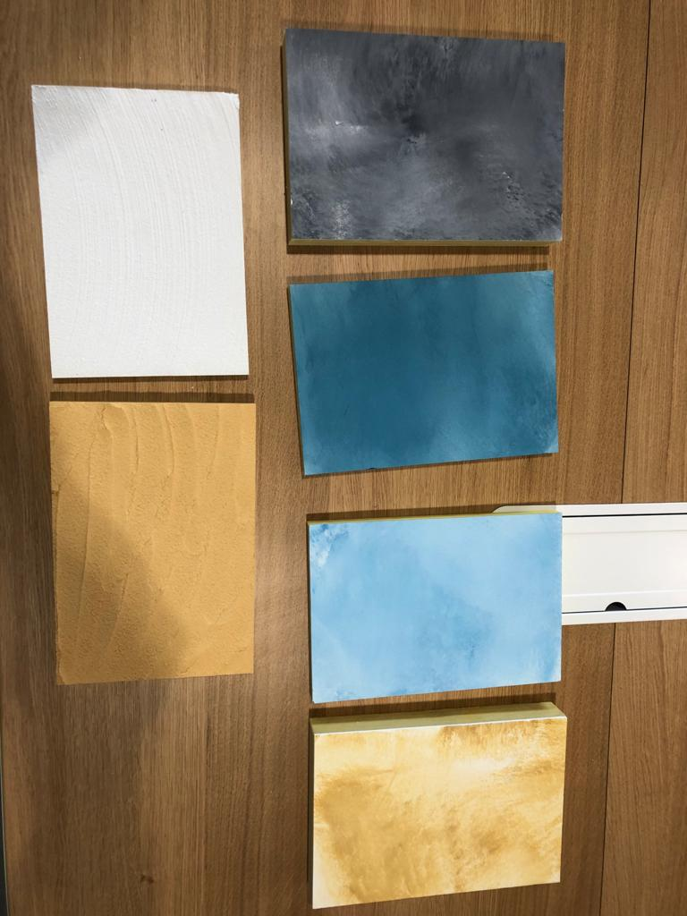
Special effects options
Sky Effect
Marble Effect
Timber/wood Effect
Other Effects

Slide 12
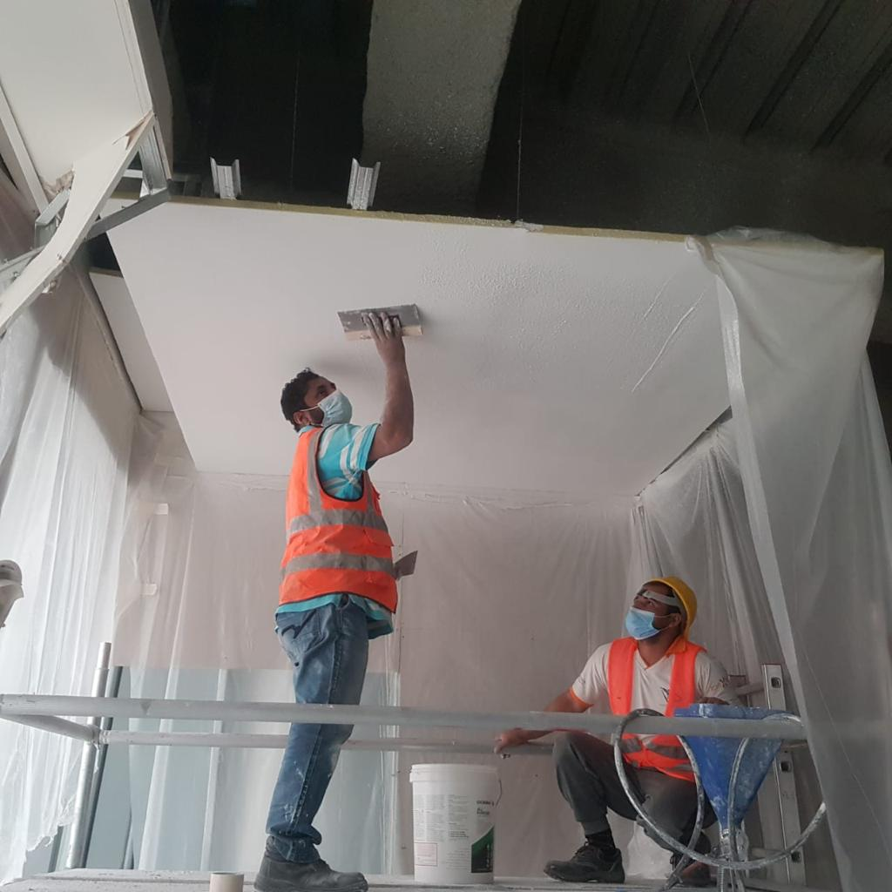
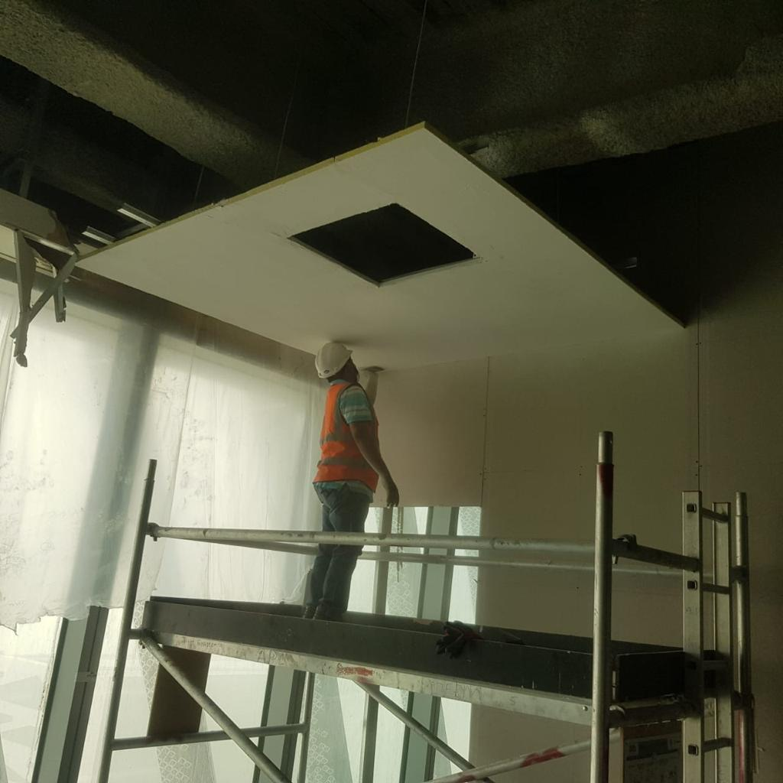
Finishing images from site
Finishing under progress
Cut out for Access Panel

Slide 13
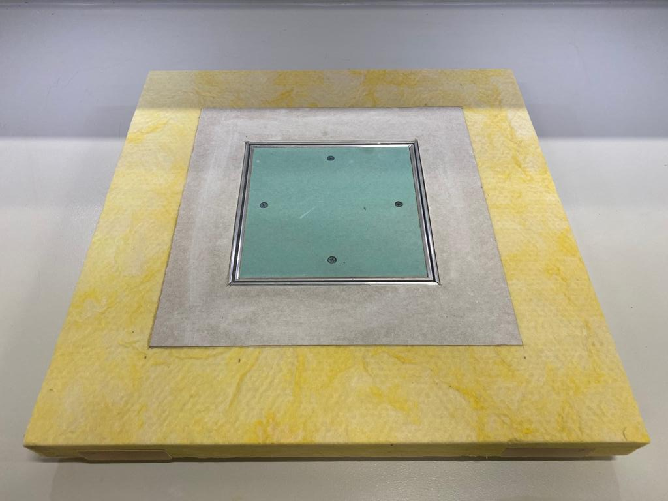
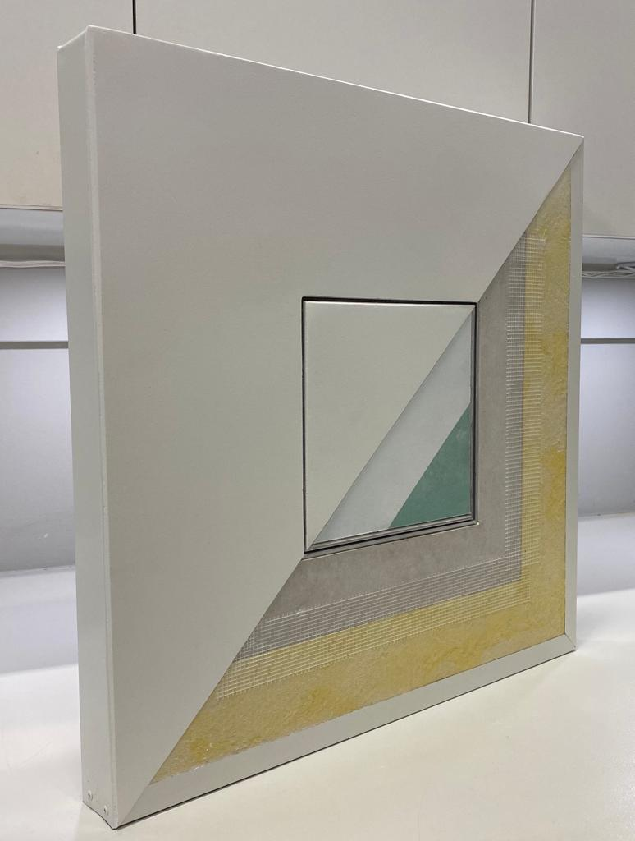
Integration with Saint-Gobain Gyproc access panel

Slide 14
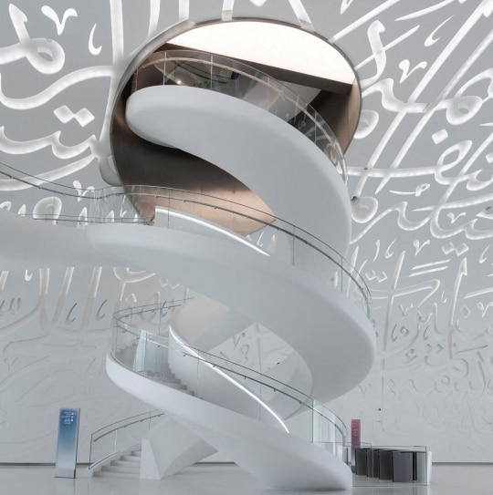
Finishing images

Slide 15
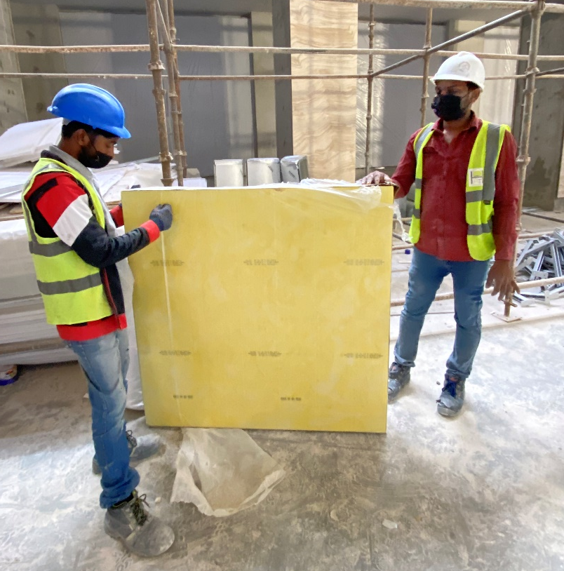
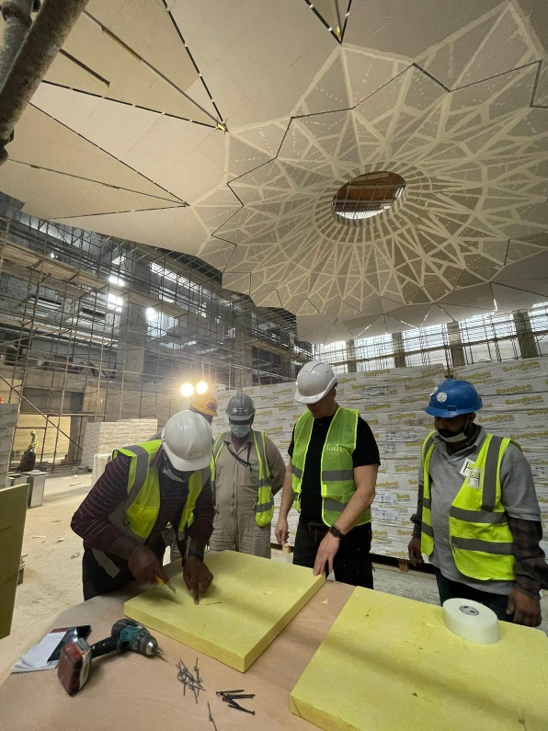
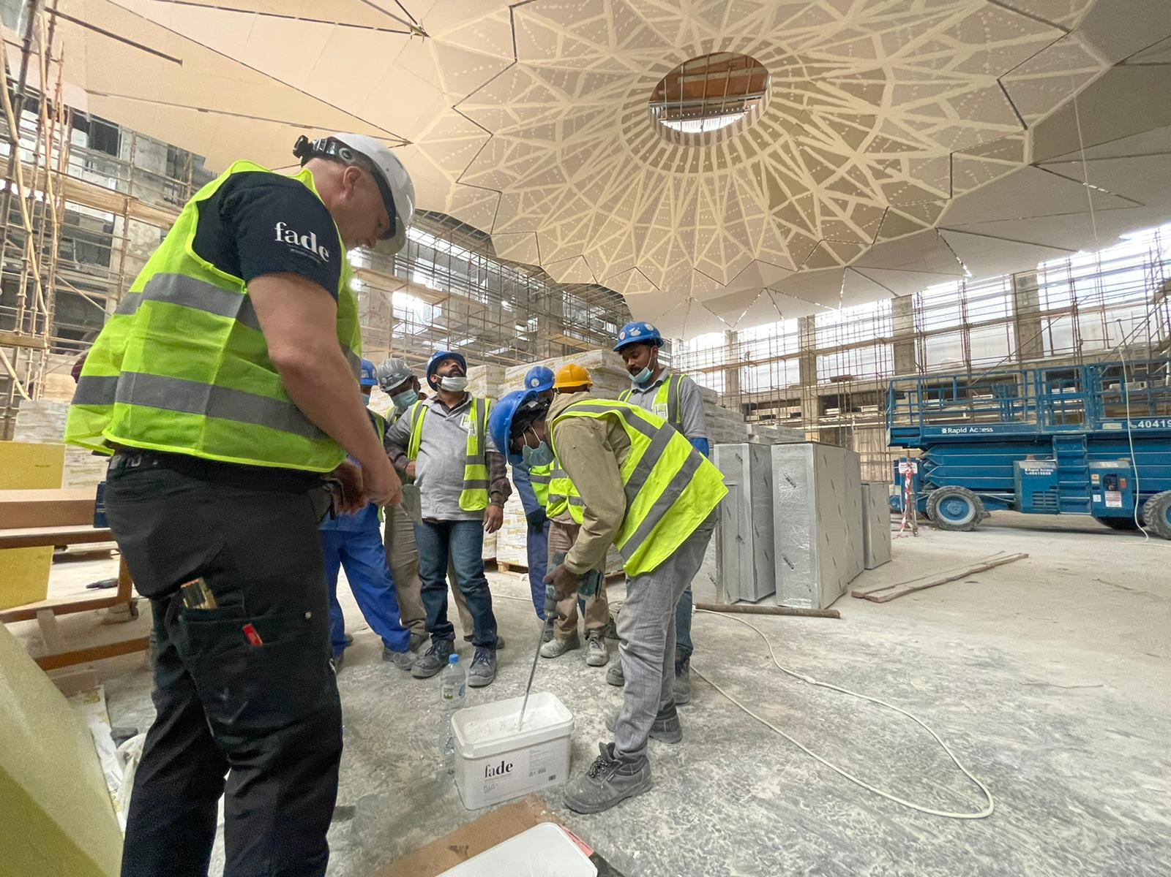
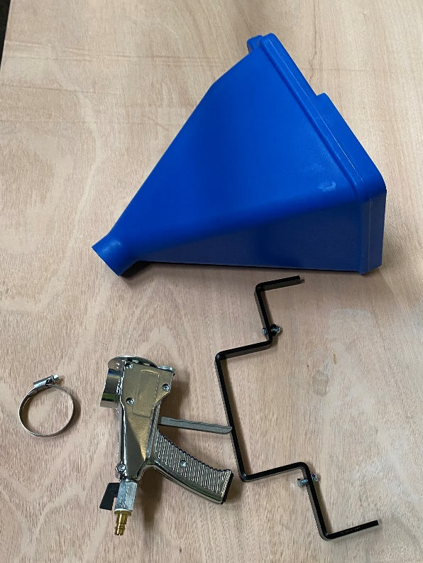
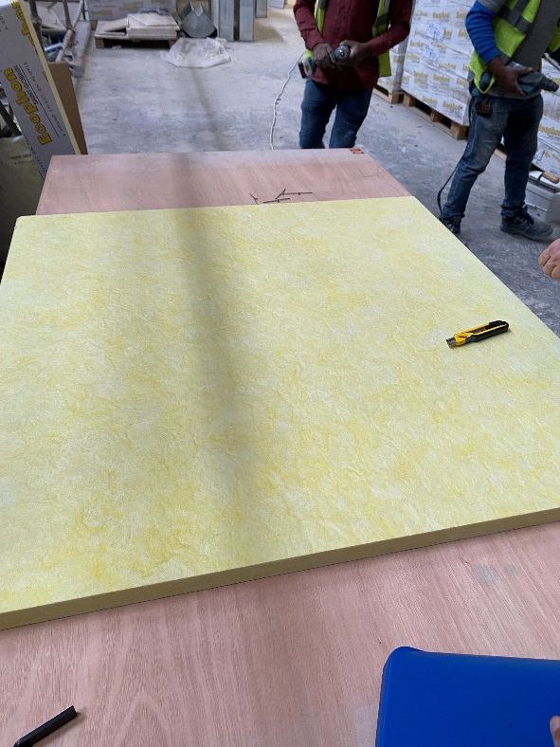
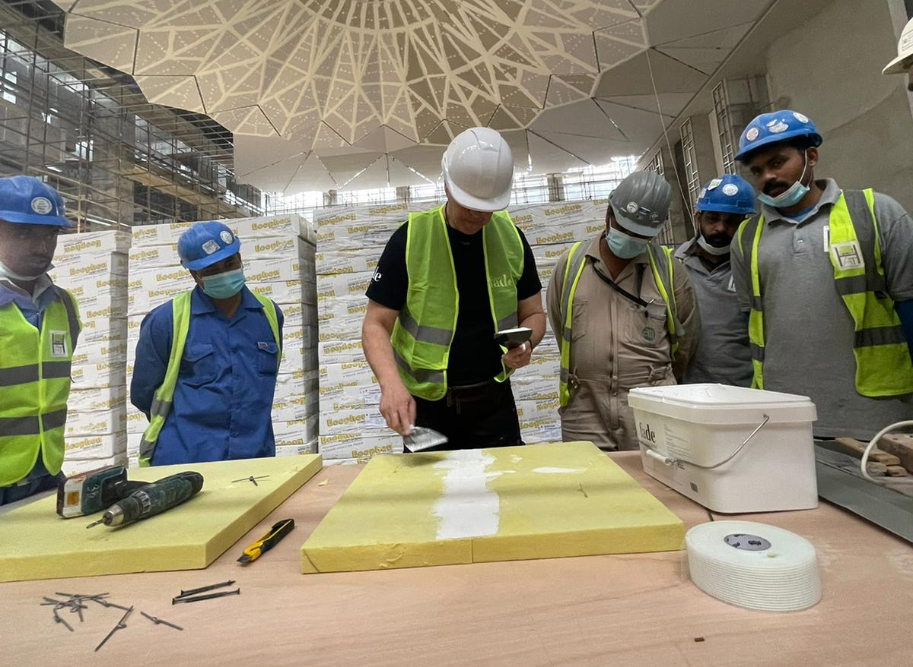
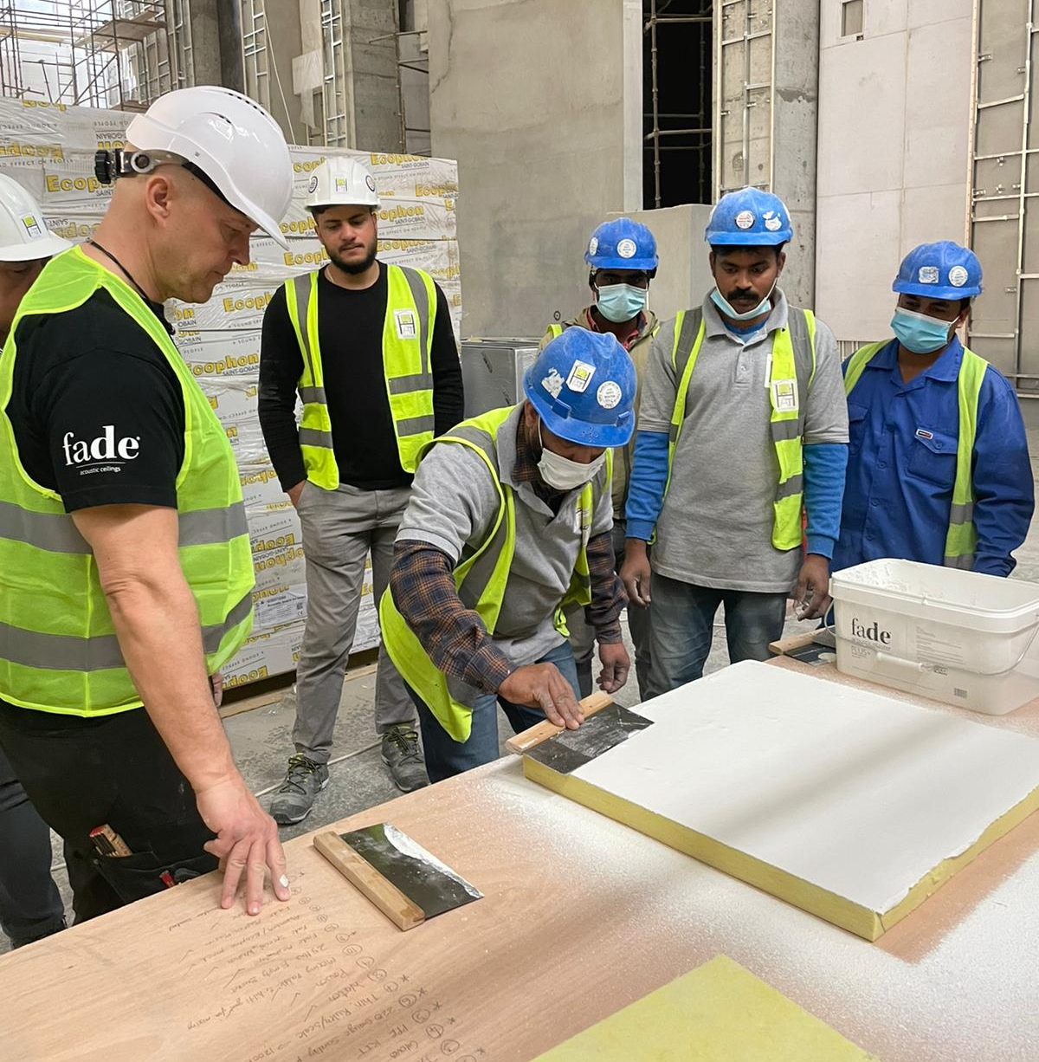
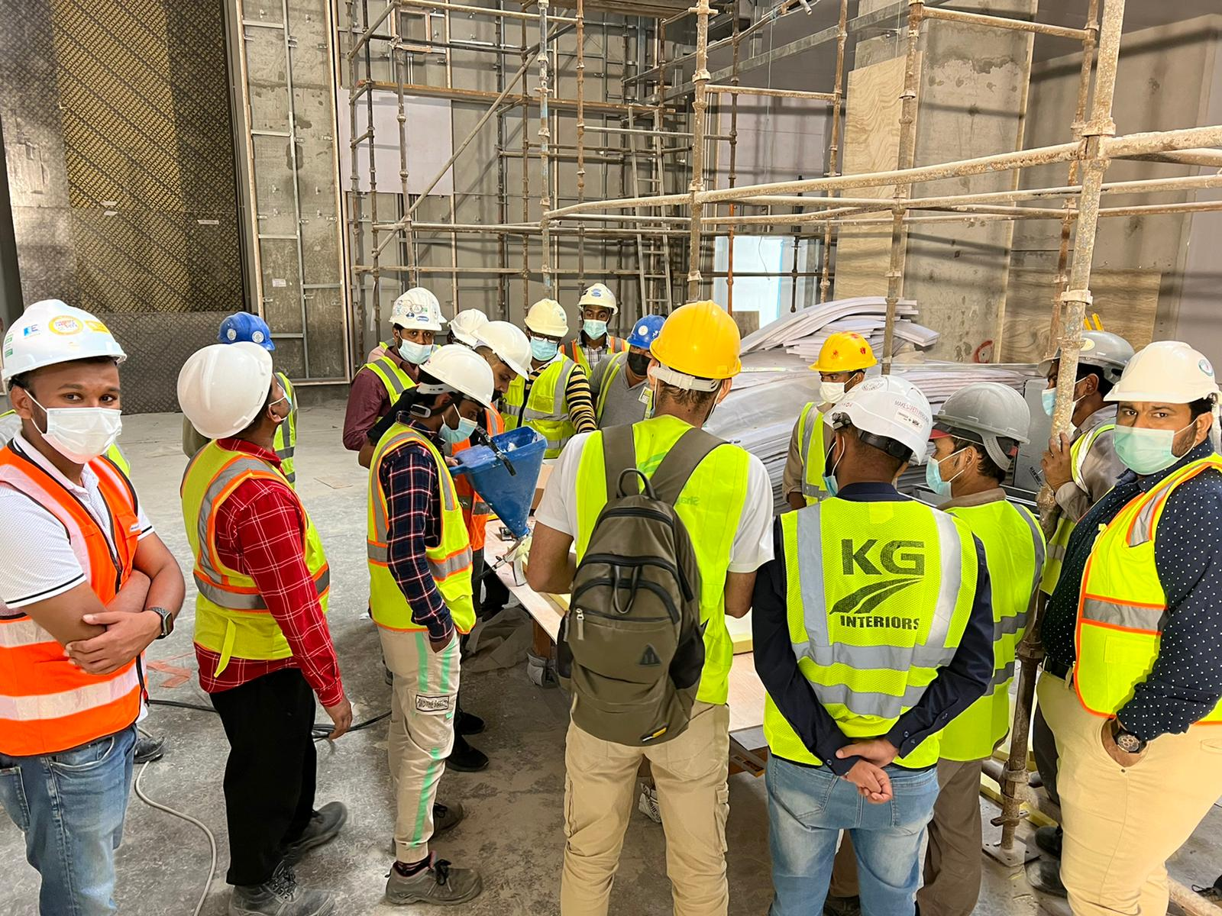
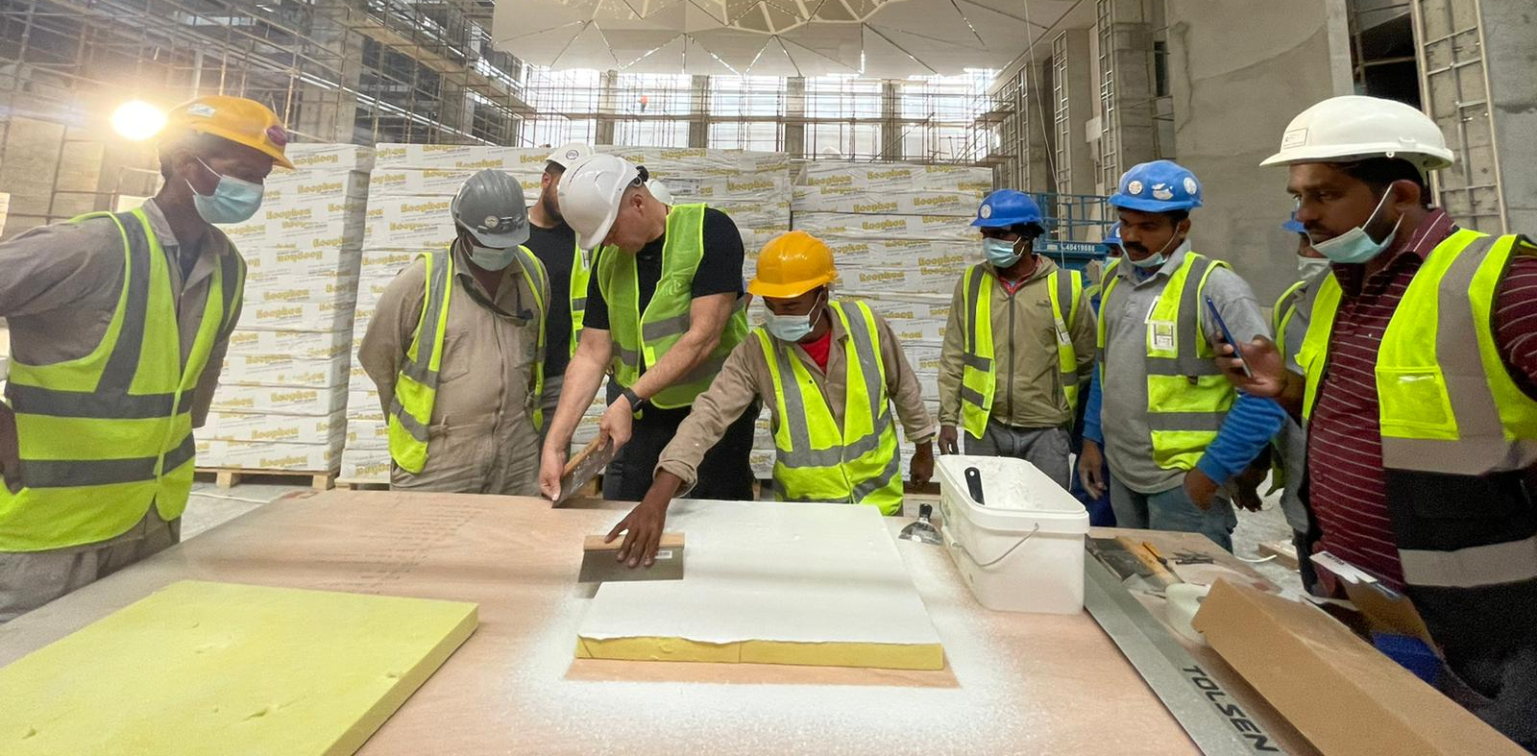
Site support & training activity

Slide 16
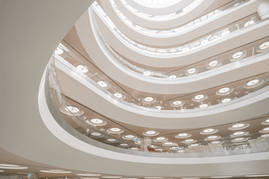
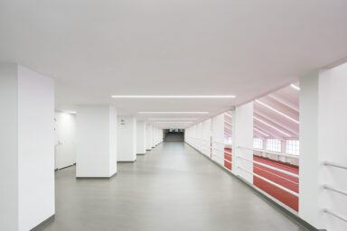
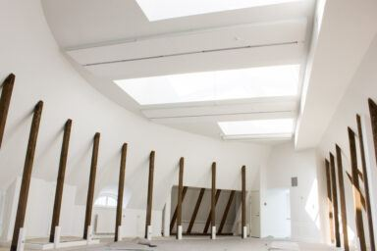
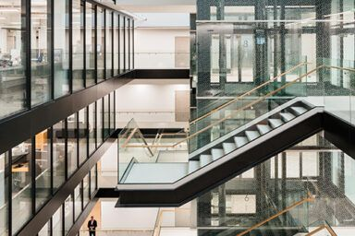
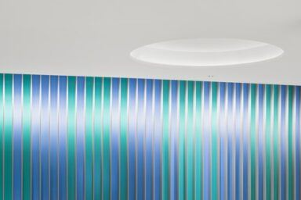
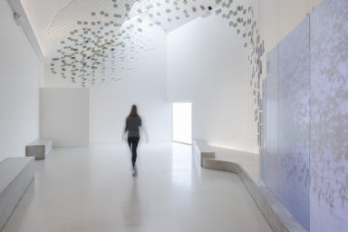
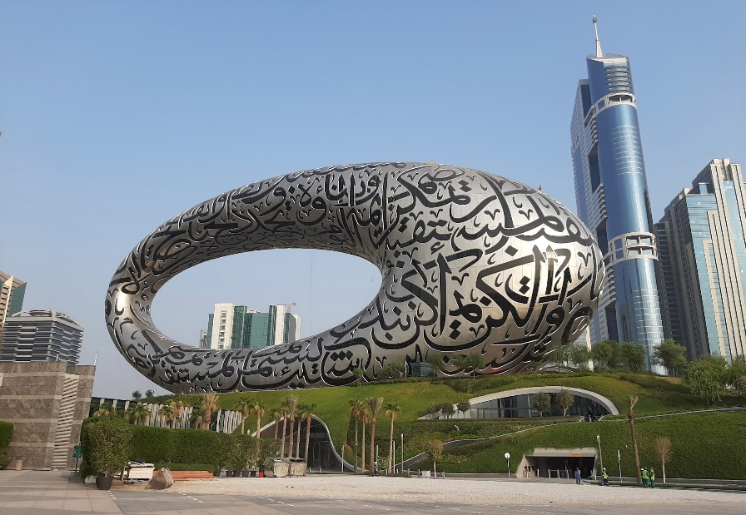
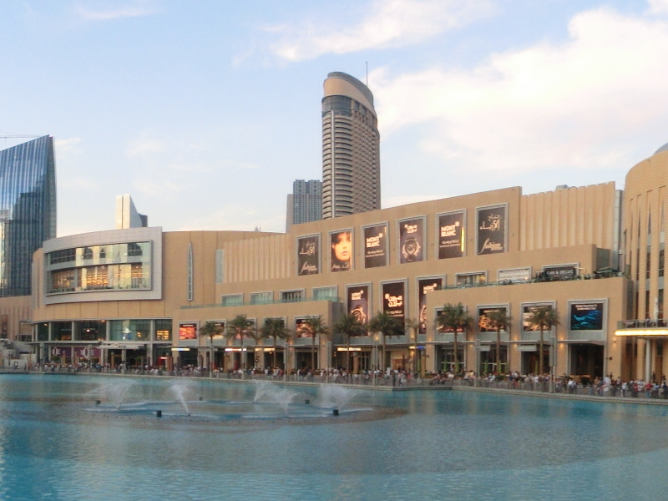
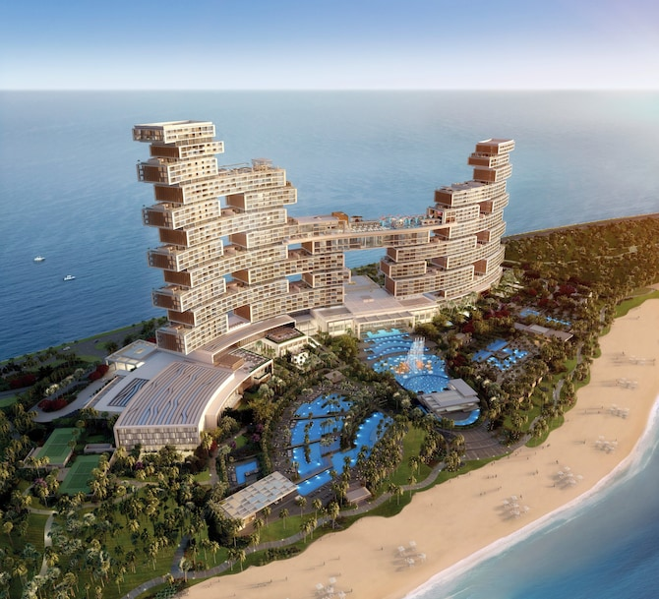
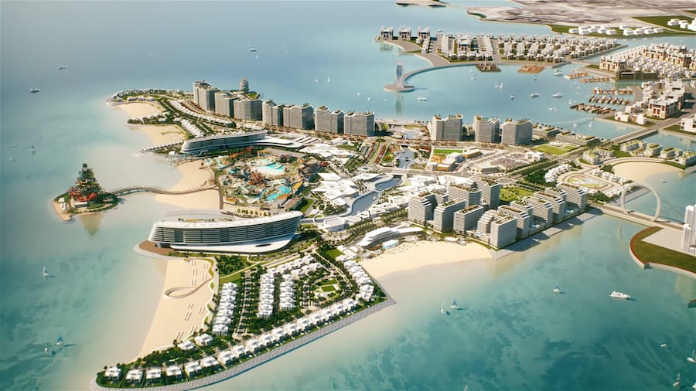
Few Reference projects
Hankook Tire HQ
The Eiffel Tower – Le Jules Verne
Helsinki Olympic Stadium
Holmens Kanal 9
European Chemicals Agency
Niittykumpu Metro Station
Wadden Sea Centre
Museum of the Future
Dubai Mall
Royal Atlantis
Juma Mosque – Qeitaifan island

Slide 17
THANK YOU

